Slide 1


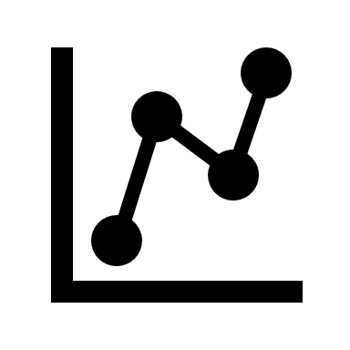
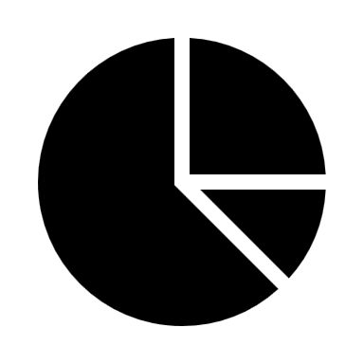





Homeopathic medicine Analysis

Slide 2
Project Team
Abhishek Singh
Divye Chopra
Sanjit Kumar
Md. Zamam Ahmad

Slide 3
Objective
Generate medicine aggregations by benefit area, brand, and ingredient.
Analyze pricing, ratings, and ingredient usage across benefit areas.
Create an interactive dashboard for homeopathic store cost analysis.
Provide insights for selecting the best medicine based on benefit area.

Slide 4
Project Execution
Web Scrapping
Pandas
BeautifulSoup
Data Framing
Pandas
Data Cleaning
Pandas
Excel
Dashboard and getting Insights
Excel
Pandas

Slide 5
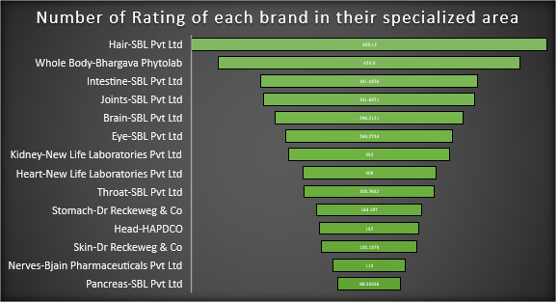
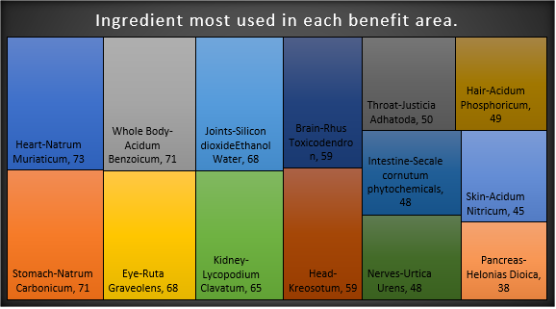
1Mg Homeopathic Dashboard

Slide 6
Project Insights
The most used ingredient is Belladonna.
The number of medicines in the benefits area Eye is highest.
SBL Pvt Ltd and Bjain Pharmaceuticals Pvt Ltd are the brands that have the most medicines with the average selling price of ₹144.89 and ₹132.31 respectively.
SBL Pvt Ltd has the highest average number of ratings, i.e. ₹ 559.12, in the Hair-benefit area.
The average cost for ingredients is ₹184.86.
The brand SBL Pvt Ltd has most greater than 4-point review medicines.

Slide 7
Project Insights
Maximum Selling price range of medicine for each benefit area ₹ 873 to ₹ 4050.
Minimum Selling price range of medicine for each benefit area ₹ 36 to ₹ 56.
Selling Price range for Kidney is maximum i.e. 38-3400.
Selling Price range for Brain is minimum i.e. 56-873.

Slide 8
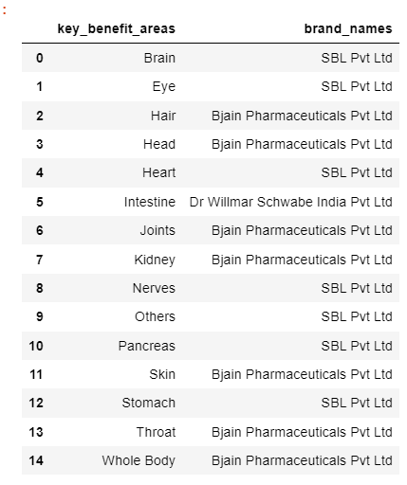
Project Insights
Brand specialization(Key Benefits) of each area
SBL Pvt Ltd and Bjain Pharmaceutical Pvt Ltd are the two brands that are used most among the benefit areas.

Slide 9
Estimation of the cost of opening a medical store
Key_agg | Estimated Amount(₹)
Licenses | 50k
Advertising and marking expenses | 10k
Insurance | 50k
Equipment and suppliers | 2 lakh
Rent for the store | 20k
Salaries | 25k
Medicine Cost | 6 lakh
Others | 1.5 lakh
Total Cost | 11 lakh

Slide 10
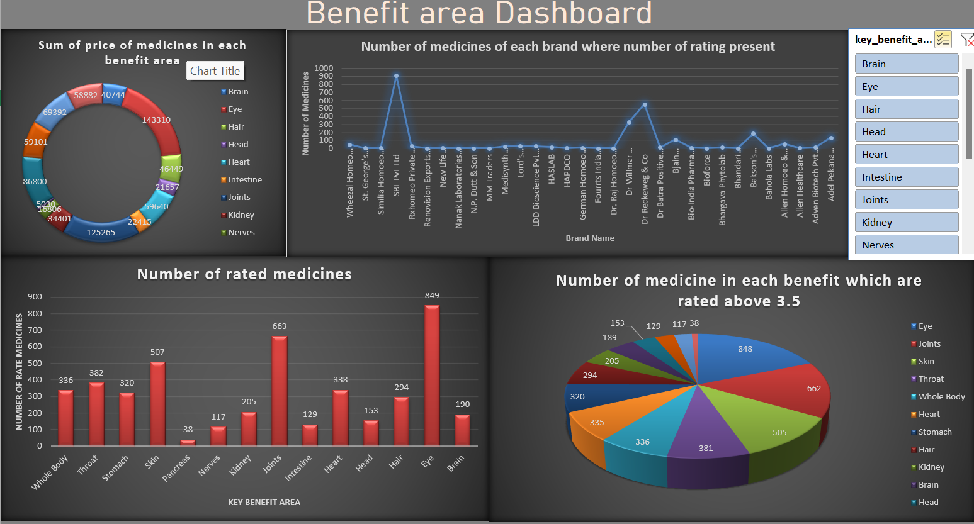

Slide 11
Summarized Insights from Dashboard
Sum of the price of medicines is highest for Eye benefit area.
The Brand SBL Pvt Ltd has the highest number of medicines of where a number of ratings is present.
Most rated medicine is from the Eye benefit area.
The highest number of medicine, which are rated above 3.5, is from the Eye benefit area
So, medicines of Eye benefit area would be recommended to purchase or from the brand SBL Pvt Ltd.

Slide 12
Challenges Faced
Got banned from the 1Mg official website multiple times while data scraping, to resolve we used Google Colab.
Scraping details of each individual medicine took longer than excepted (mainly because of some duplicate data)
Future Scope
The future scope includes incorporating ML algorithms for predicting medicine demand, personalized recommendation systems, and detecting fraudulent practices.

Slide 13
Thank You

